Slide 1
AIRLINE RESERVATION SYSTEM
PROJECT TITLE
COMPUTER SCIENCE & ENGINEERING
SEMESTER - IV

Slide 2
GUIDE BY:- DR. SOURAV DE
PROJECT BY:-
SUVADIP MANDAL
SURAJIT SARKAR
RABINDRANATH SAHU
SOUMEN MAHATA

Slide 3
CONTENTS
ABOUT INSTITUTE:-
COOCH BEHAR ENGINEERING COLLEGE

Slide 4
Introduction of Airline Reservation System
Airline reservation system is a computerize system.
Enhancing the relationship between customer and airline agency.
Convenient for the customer to book the flights.
Allow the employ the access database and allow new employ will be added by admin.

Slide 5
System Requirements:
Software Requirements | Hardware Requirements
Operating System: Windows 7, Windows 8 & Windows 10 | Processor: Any
User Interface: | Hard Disk: 1 GB
Programing Language: VB Studio | RAM: 2 GB
Database: MS Access | DISPLAY :1366 x 768

Slide 6
User Functionality:
Without LogIn Flight Search Flight Status Check Check In Flight Flight Booking View Booking Login/Sign up New Registration Choose Add-on Facility Payment Option Ticket Print | With LogIn Special Offer Passenger List Manage Booking/Cancel Booking Change Password Personal Details Update Book Flight Flight Status Check-in View Booking Notification Weather Schedules

Slide 7
Without Login

Slide 8
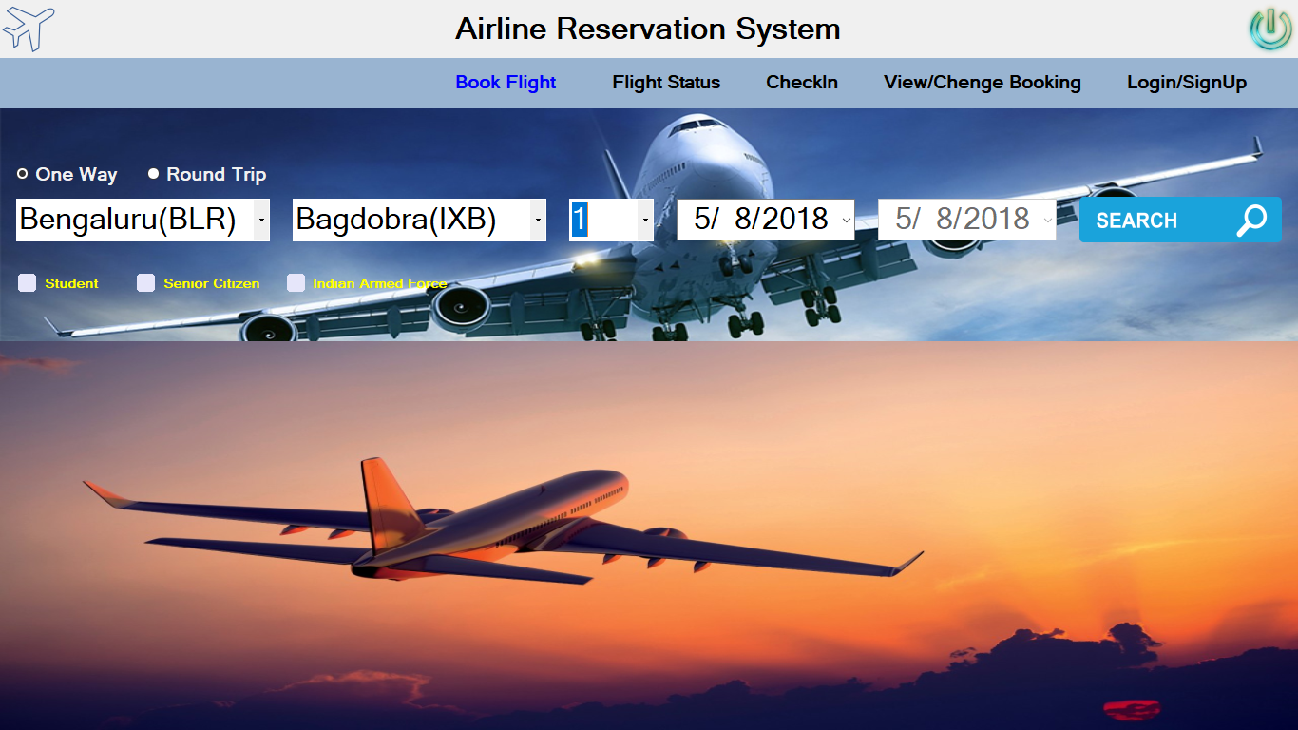
Home Page

Slide 9
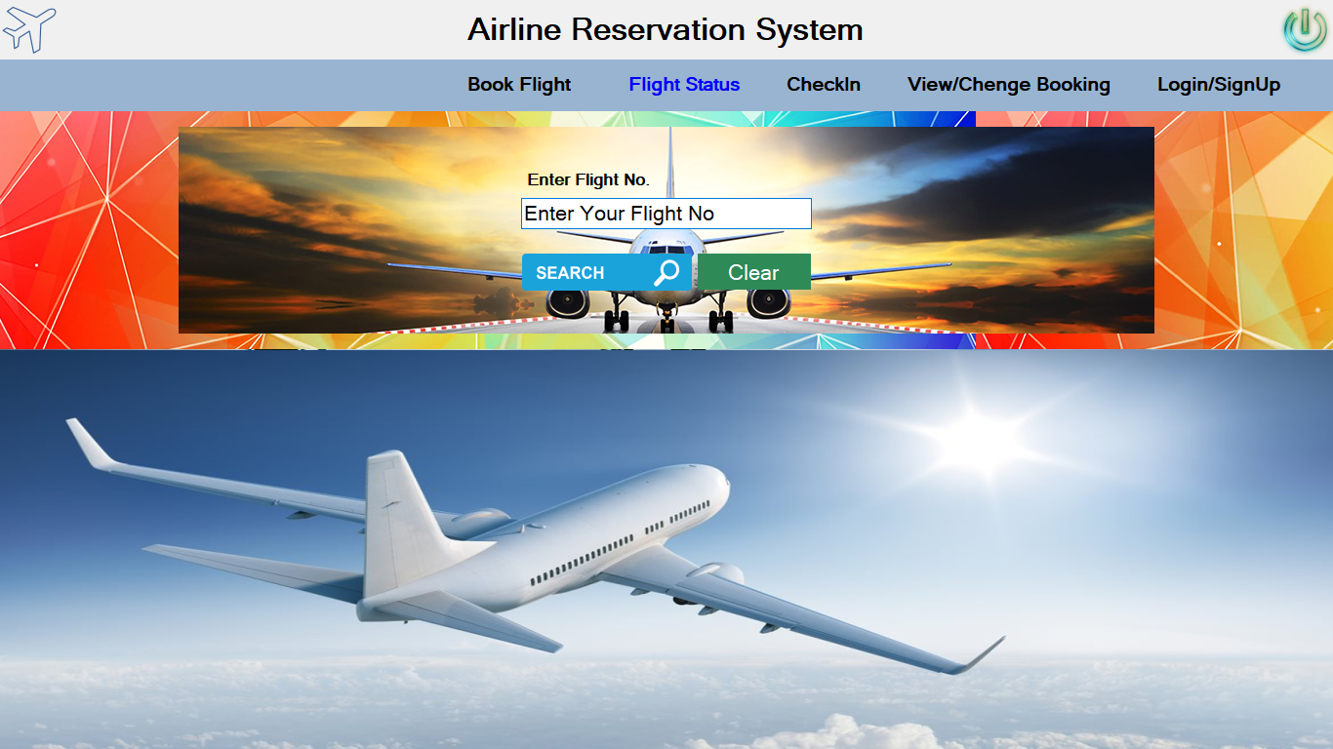
Flight search

Slide 10
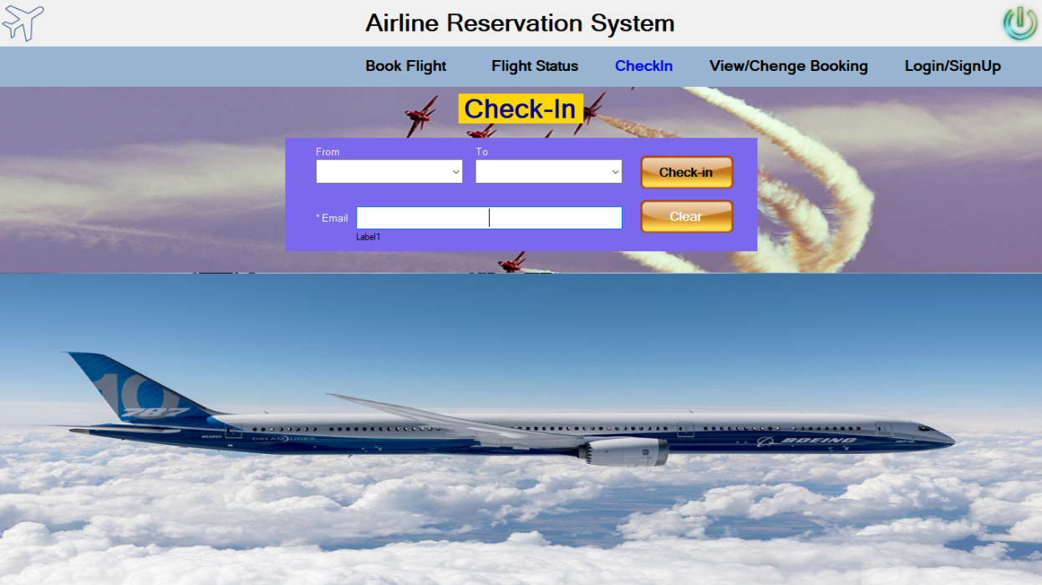
Check In Flight

Slide 11
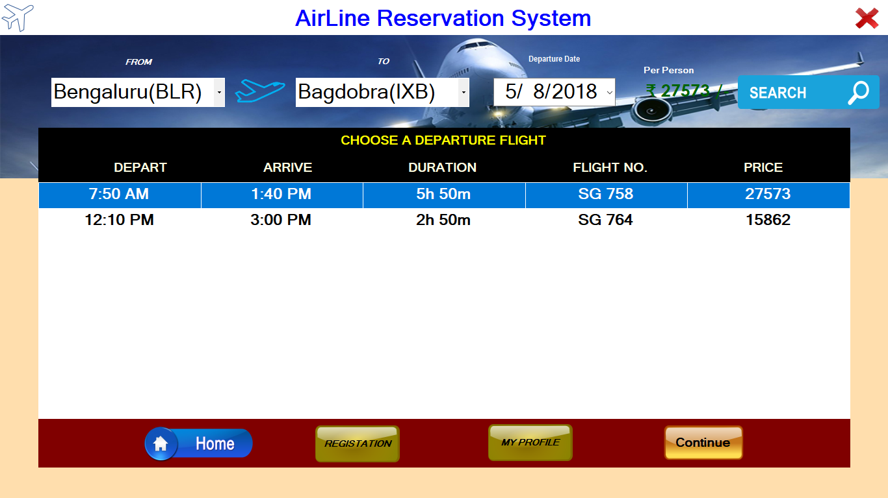
Chose Different Flight Option

Slide 12
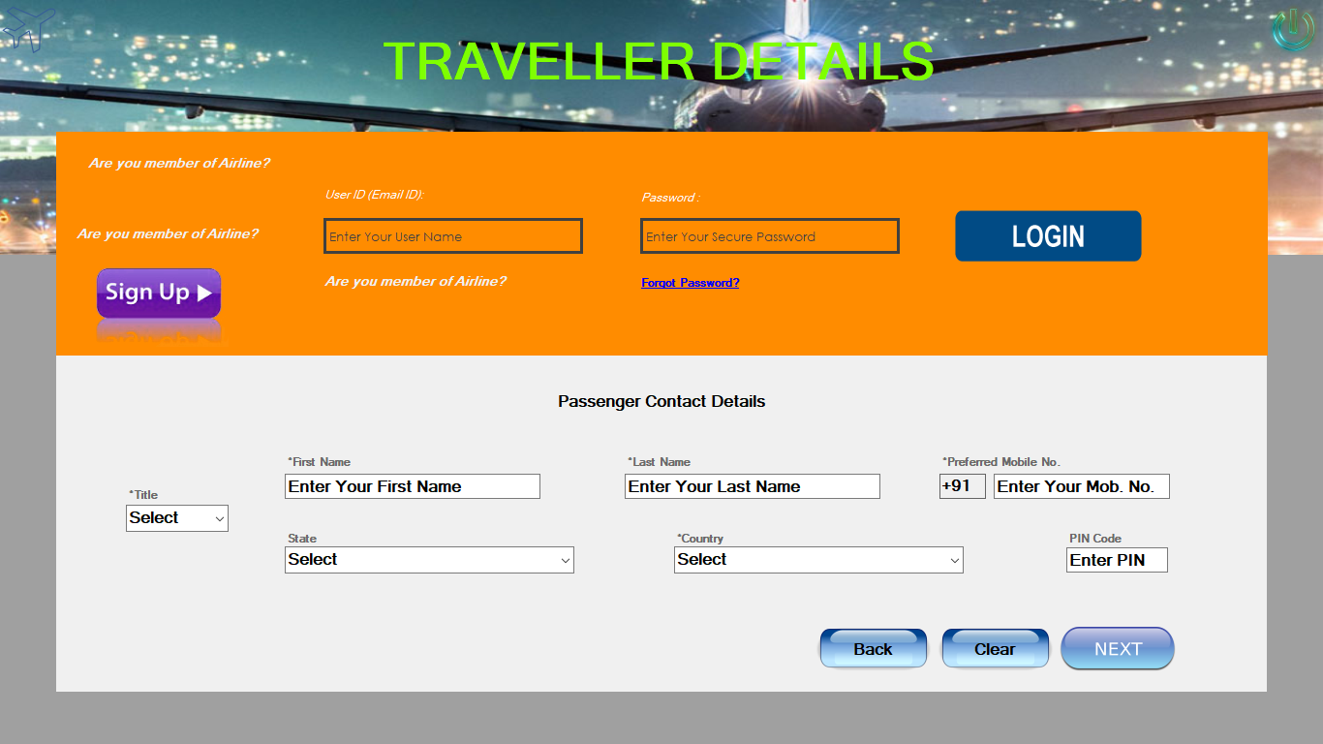
Travel Details & Login & Sign Up Option

Slide 13
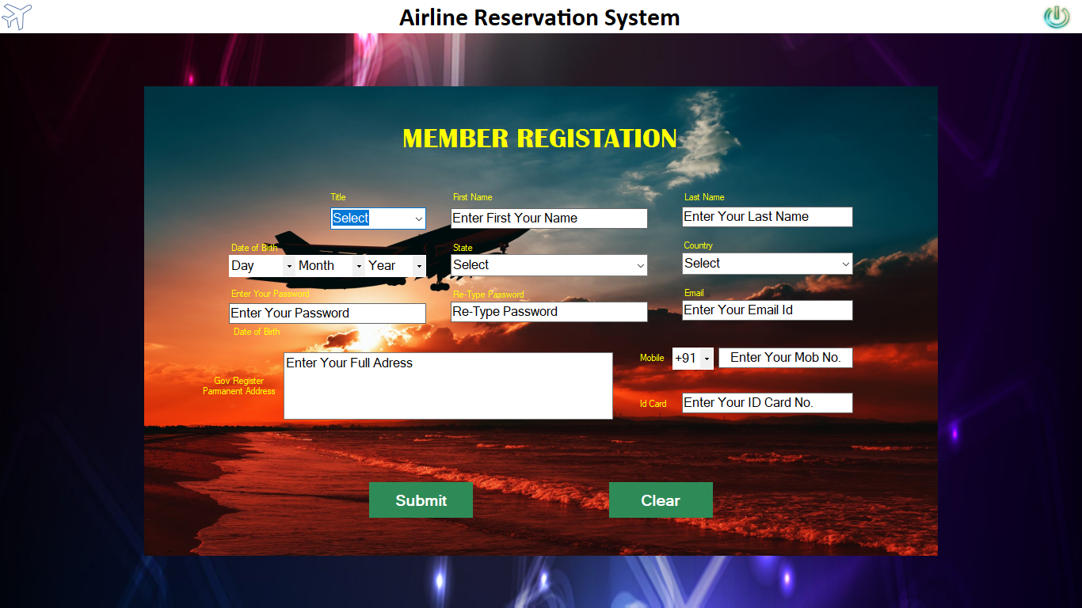
Member Registration

Slide 14
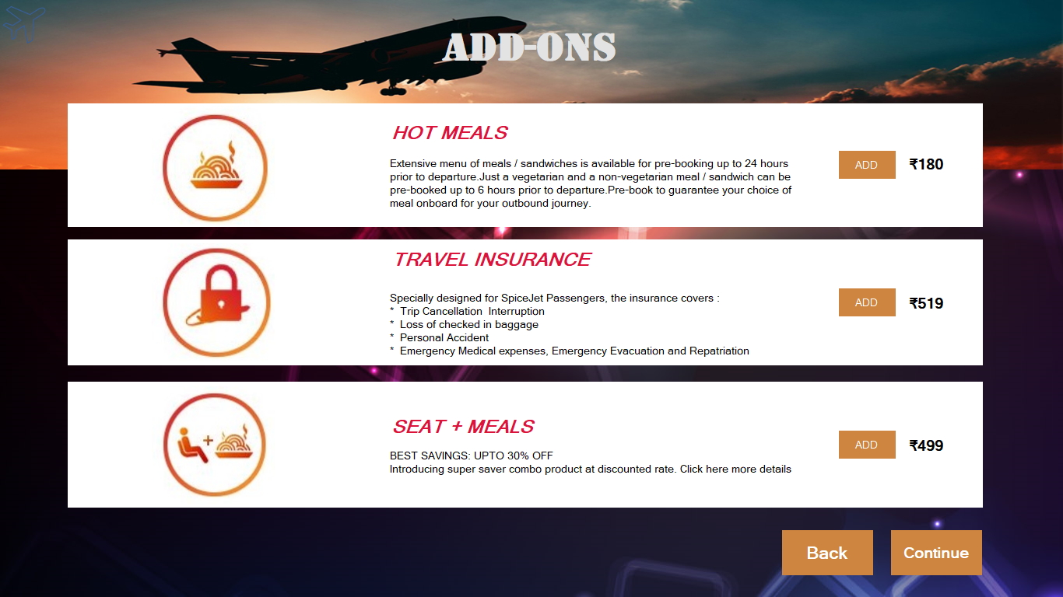
ADD-ON

Slide 15
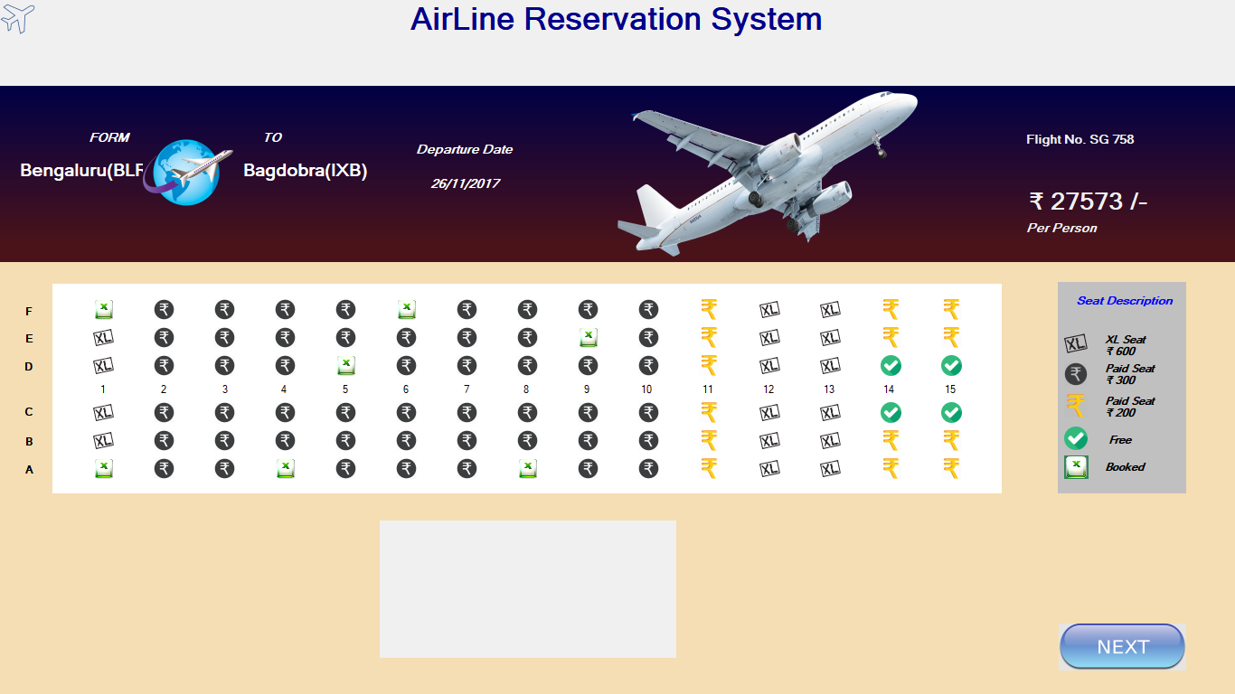
Chose User Like Seat

Slide 16
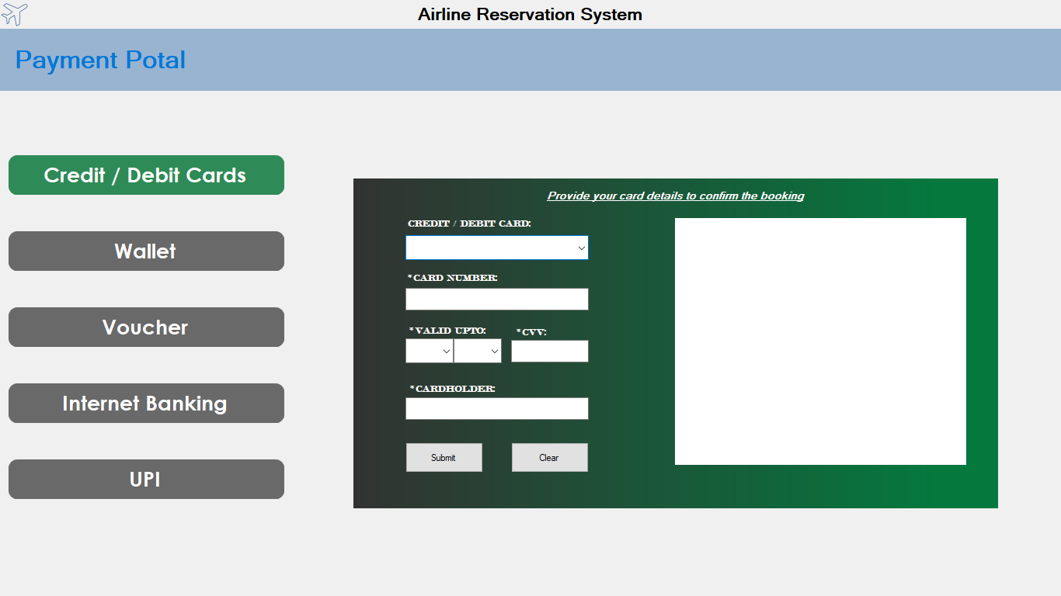
Payment Option

Slide 17
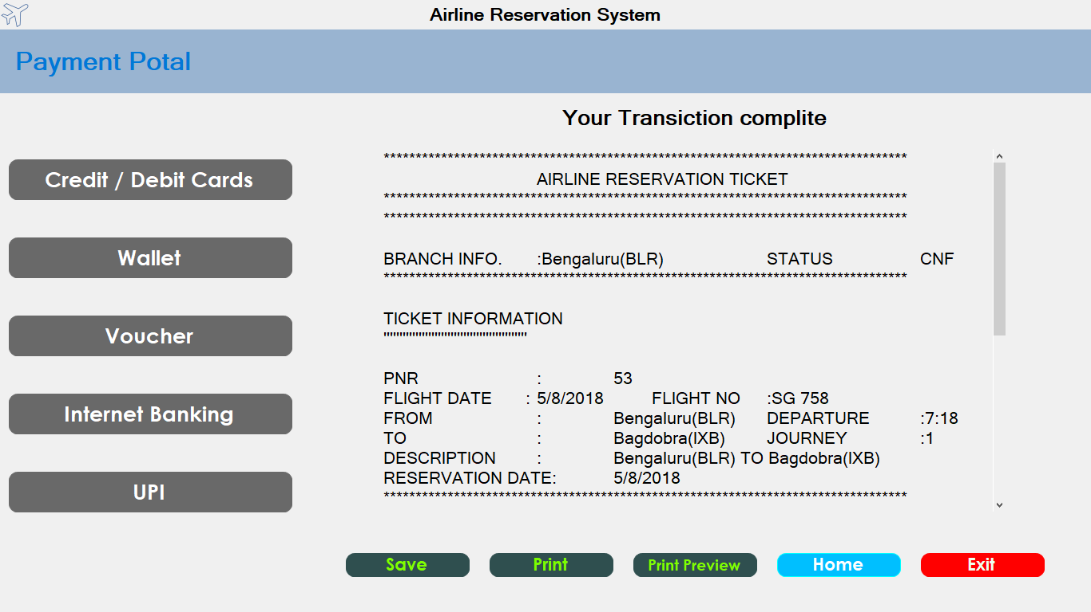
Ticket Information & Print

Slide 18
With Login

Slide 19
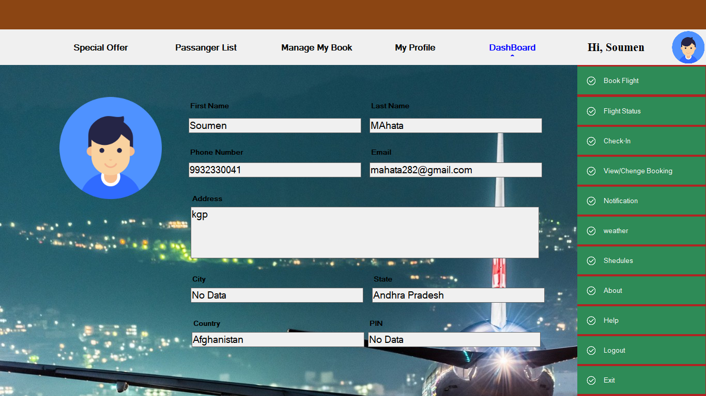
View Profile& Update

Slide 20
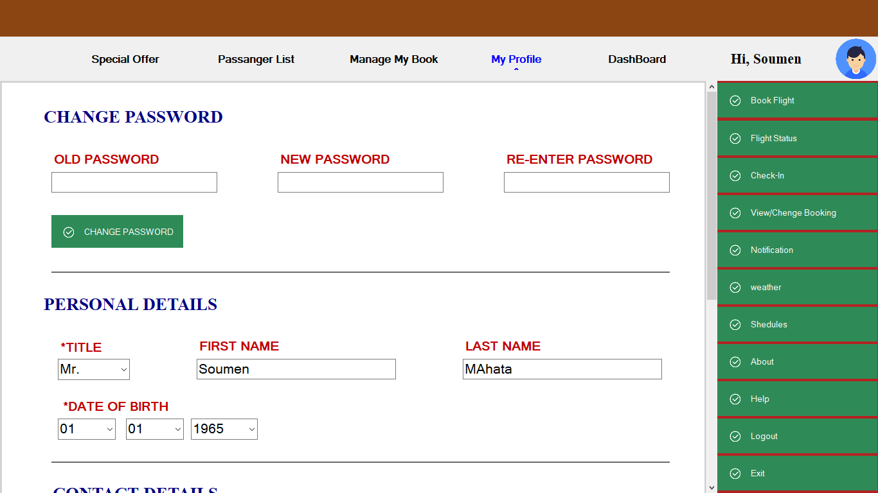
Change Password

Slide 21
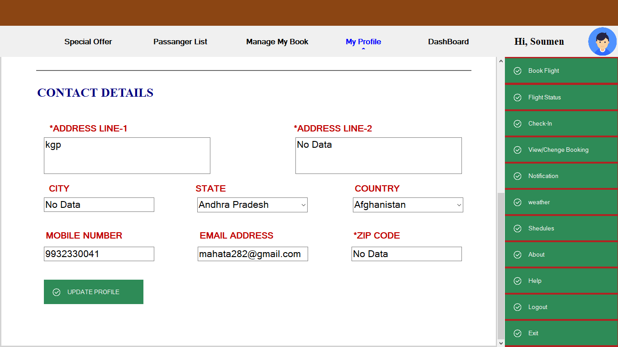
Profile Update

Slide 22
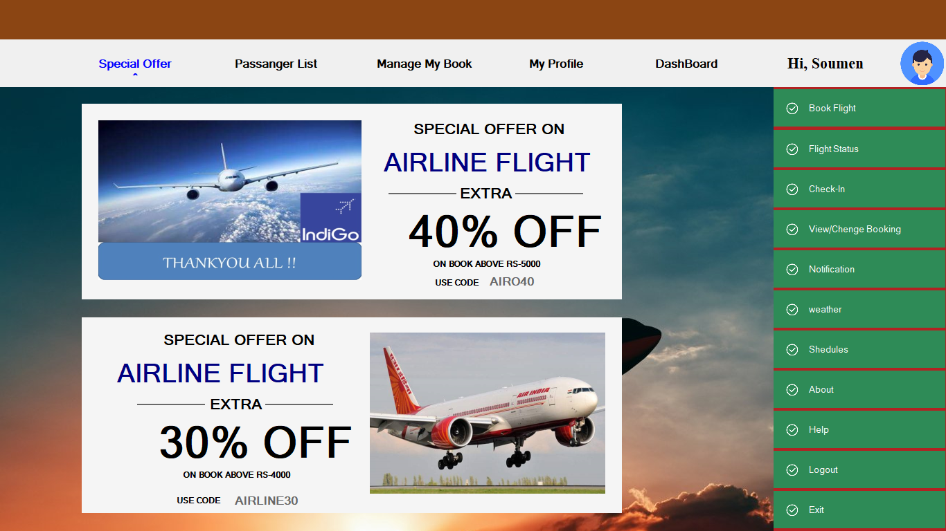
Special Offer

Slide 23
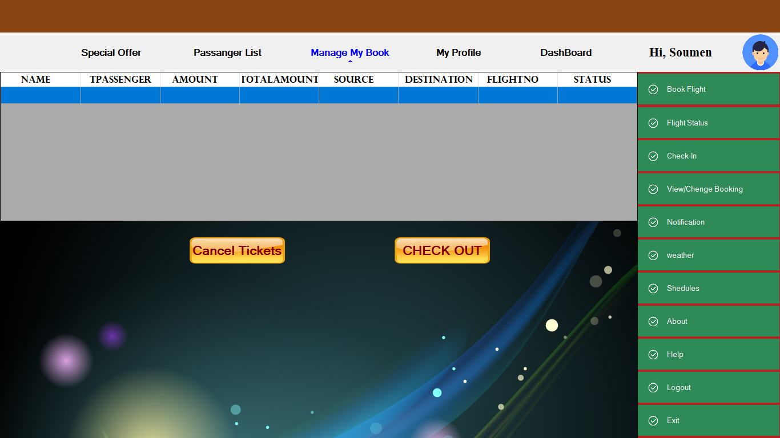
Manage Booking

Slide 24
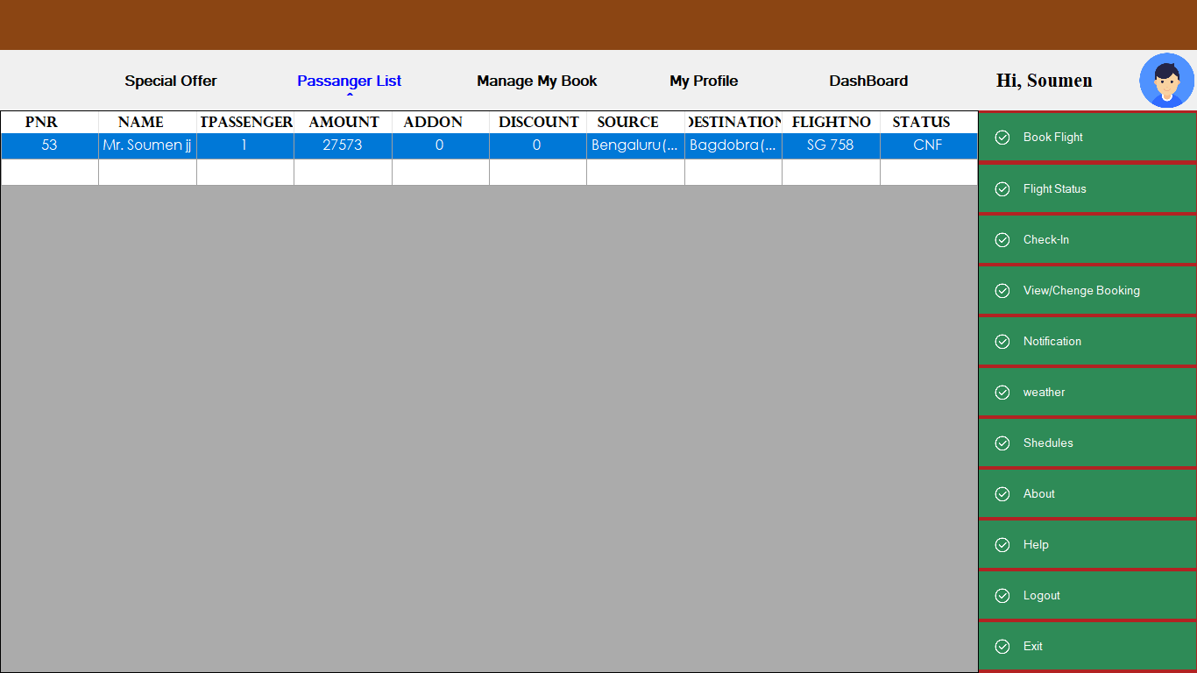
Passenger List

Slide 25
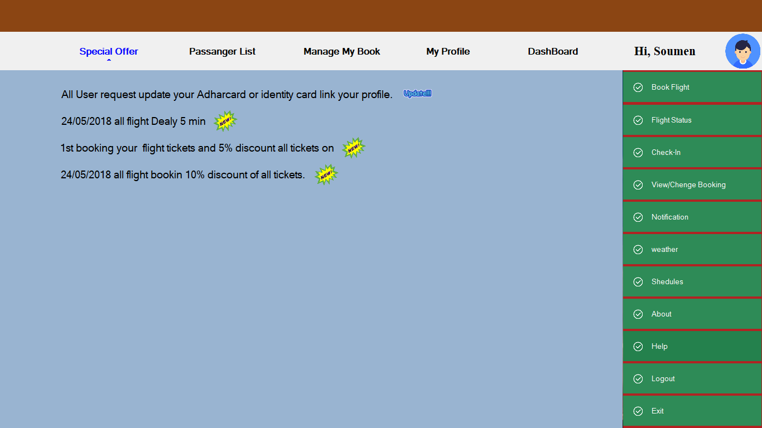
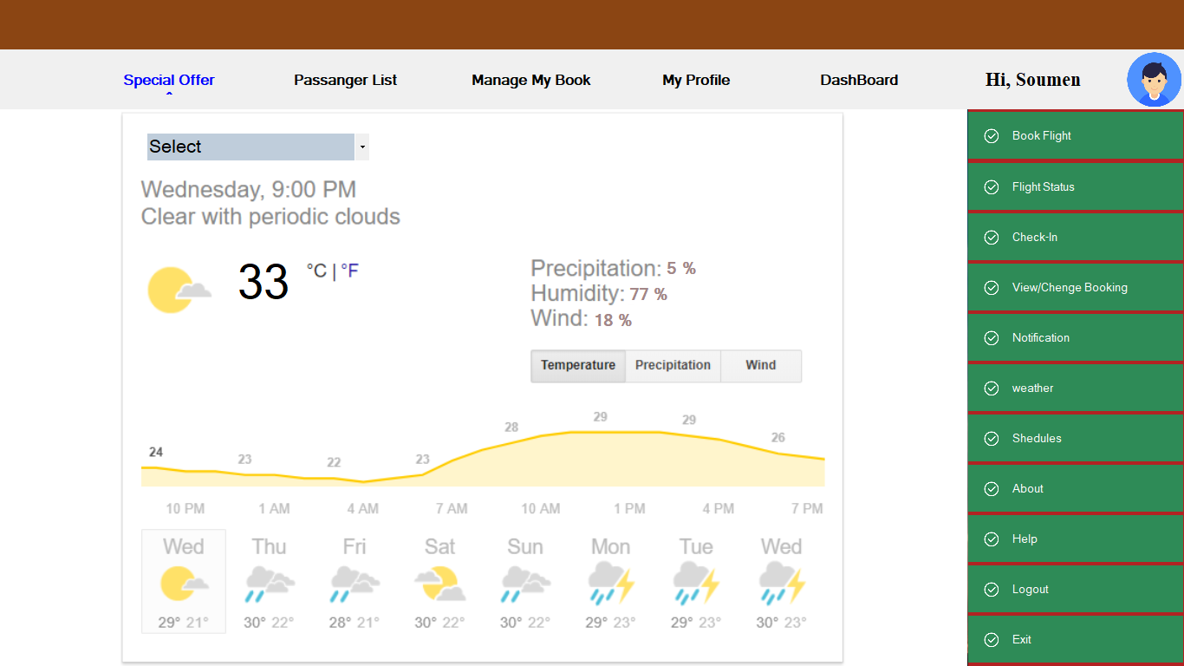
Notification & Weather

Slide 26
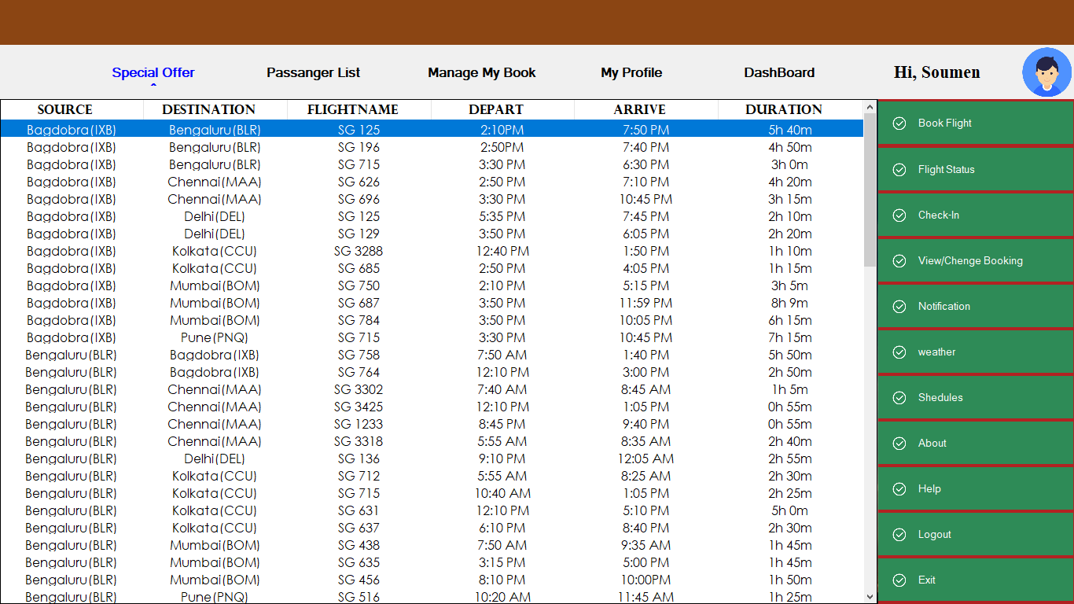
Flight Schedules

Slide 27
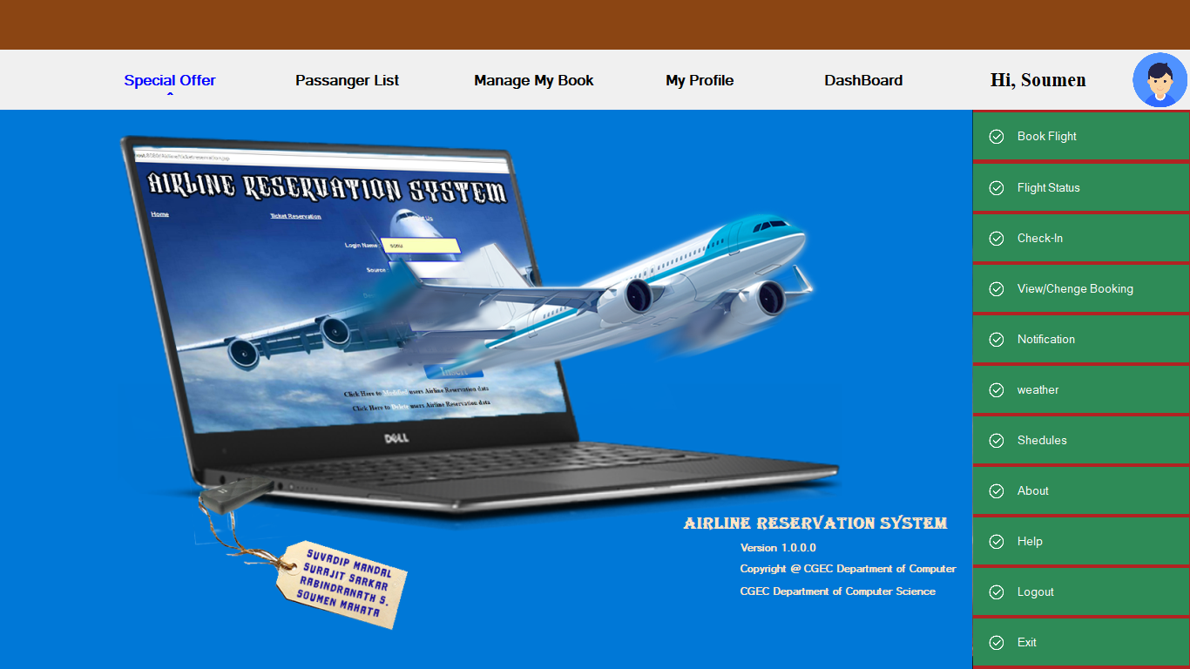
About

Slide 28
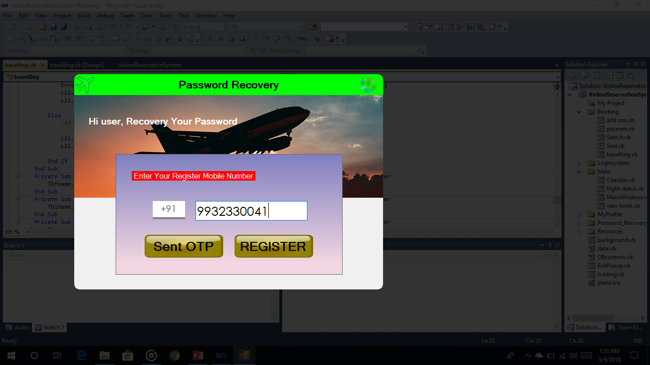
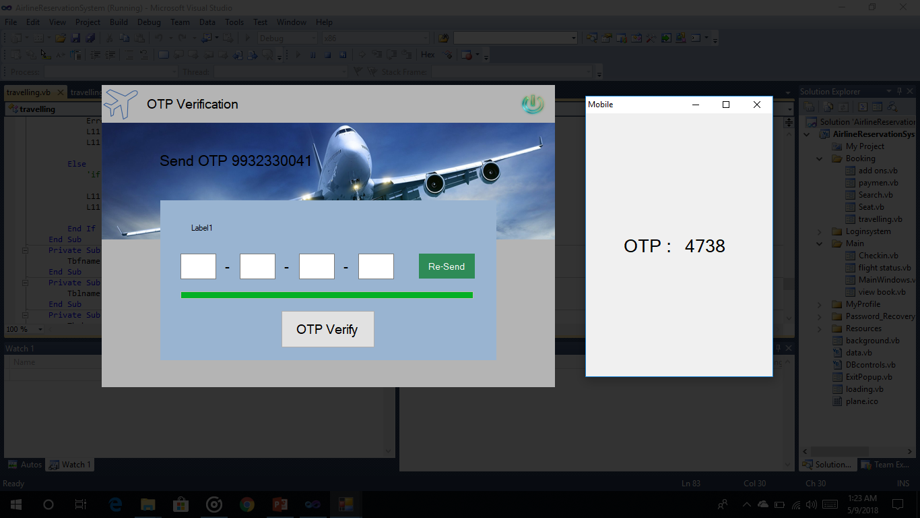
Forgot Password & OTP verification

Slide 29
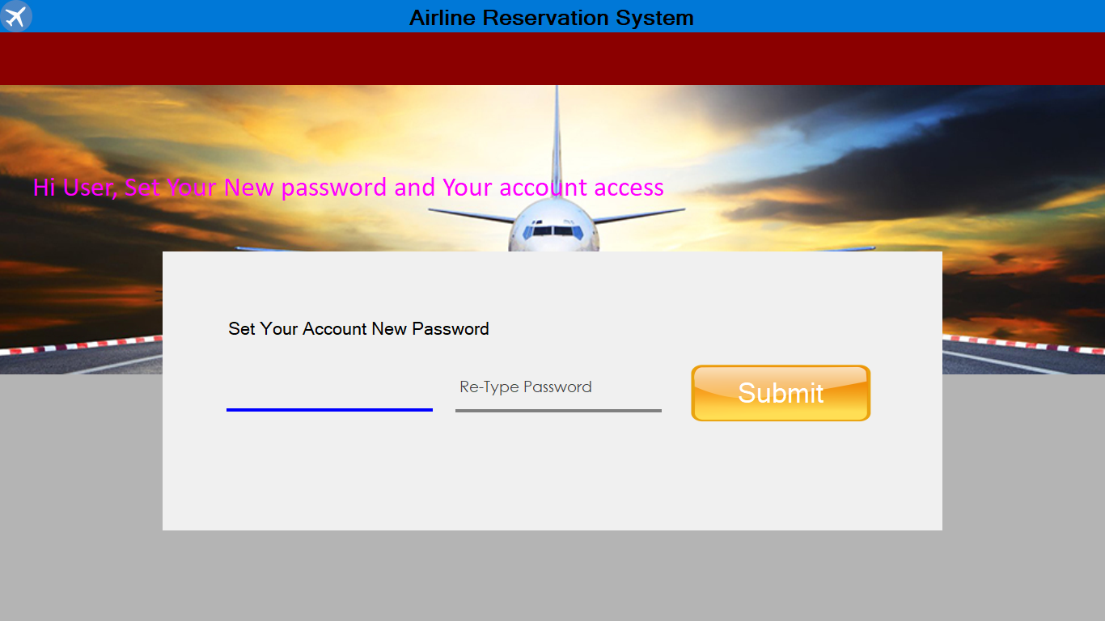
Reset Password

Slide 30
Conclusion:
The application is developed in Visual Basic Studio.
Airline Reservation system is a desktop application
Which provide ticket reservation system.

Slide 31
Thank You

